Slide 1
Hands On The Pine
Alicia Conklin
Coordinating Seminar
Dr. Fothergill

Slide 2
Goals
Students will explore various forms of measurements and estimations.
Students will determine estimations and mathematical formulas for future calculations.

Slide 3
Objectives
Given: pine tree cores , measurement methods provided, determine age and height.
Given: coordinated paper, graph age and height of each example determined.
Given: graphed measurement data, estimate growth in 20 years.
Given: graphed measured data, determine logistical growth formula and use independently and correctly.

Slide 4
Materials
12 Core slice samples of Pine Trees
4 Coordinated/Graph paper
12 Pictures of original Pines
4 Metric rulers

Slide 5
Known of Pines
What do the rings mean in a tree stomp or core?
How many feet grow in height per 1 inch diameter?
1 ring = 1 year old
1 Inch = 4 Feet
Notes:
Introduction: Engage prior knowledge

Slide 6
Procedure
Counting rings for age
Measure diameter of core for height
Notes:
Introduction: Engage prior knowledge

Slide 7
Cont’ Procedure
Create T-chart and graph
Share on Smart Board/Excel with class
Create estimations of growth
 | Age | Height
Tree 1
Tree 2
Tree 3

Slide 8
To Create Formula
Start with the level off
Numerator limits graph
Then the increase function
Denominator- Exponents of population & time (age)
Ending Formula should be:

Slide 9
Variables of Formula
Max Growth
Time (Age)
Avg. Pop. Growth
Initial Sapling Growth

Slide 10
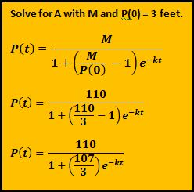
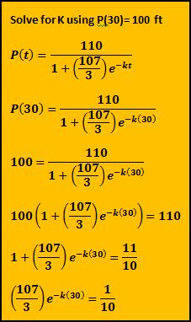
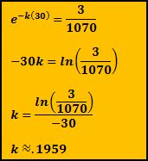
Simple Algebra

Slide 11
Formula Should Be:

Slide 12
Ending Procedure
Check Original Estimation

Slide 13
Evaluation
Report throughout activity
Worksheet with material
Questioning and labeling of variables

Slide 14
Resources
Bloom's Taxonomy. (n.d.). Old Dominion University. Retrieved April 29, 2013, from http://ww2.odu.edu/educ/roverbau/Bloom/blooms_taxonomy.htm
How tall can pine trees grow. (n.d.). The Q&A wiki. Retrieved April 23, 2013, from http://wiki.answers.com/Q/How_tall_can_pine_trees_grow
Stewart, J. (2003). Chapter 7- Differential Equations. Calculus (5th ed., pp. 535-537). Belmont, CA: Thomson Brooks/Cole.
The Logistic Function. (n.d.). Math 102- Elementary Fucntions. Retrieved April 23, 2013, from www.cs.xu.edu/math/math120/01f/logistic.pdf
Longleaf Pine Tree Growth. (n.d.). Auburn University. Retrieved April 23, 2013, from http://www.auburn.edu/academic/forestry_wildlife/longleafalliance/ecosystem/longleaftree/longleaftree5.htm

